Slide 1
PROJECT – PECUNIA (Banking System)
Presented By – Aishwarya Sarna

Slide 2
TEAM - F
Team Members –
Aishwarya Sarna
Aditya Khatavkar
Ayush Soni
Akshay Tople
Samanway Sahoo

Slide 3
EPIC AND USER STORIES OF PECUNIA
Epic 1 –
Developing Login Page for the bank Employee.
Description -
Design a log in dashboard where the employee will login to the system using his credentials.
A “signing in….” indicator will be shown to the user until he logs in, in case of delay.
User Stories -
As a bank employee if I type my credentials wrong by accident, I am presented with a pop up that says I need to provide my credentials correctly.
Given I am an employee that has successfully logged in, I want access to manage customers, transactions, loans, etc.

Slide 4
Epic 2 –
As a bank manager, I want to view customer details to approve loan.
User Stories –
As a branch manager I want to view the customer details, including the type of loan the customer has chosen.
As a branch manager I want to choose from the drop down menu, the amount of loan the customer is eligible for.
As a branch manager I want to approve the loan, or reject the loan.
As a branch manager I want to be presented by a pop up window that will say that the customer has been approved for loan successfully.

Slide 5
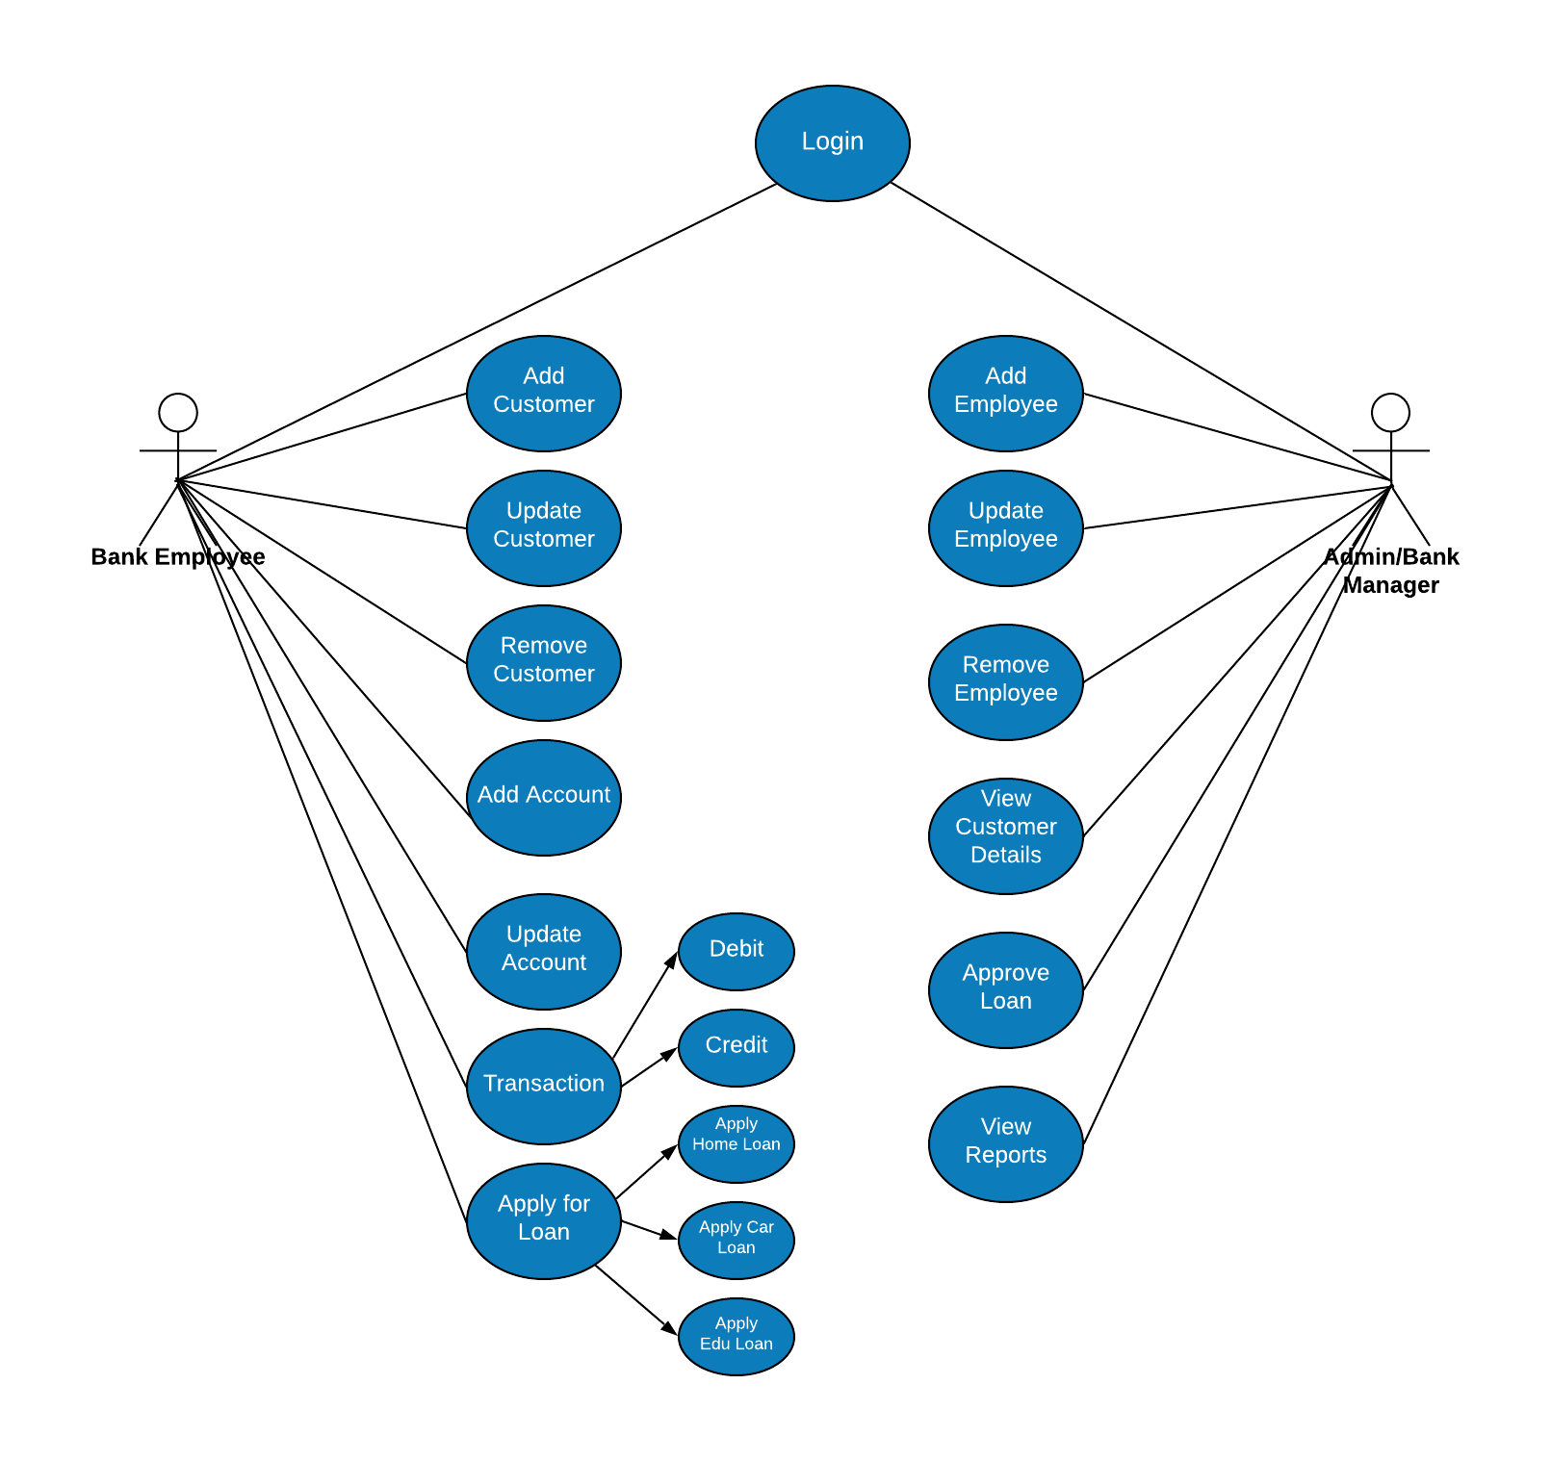
USE CASE DIAGRAM OF PECUNIA

Slide 6
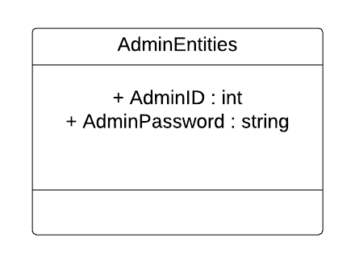
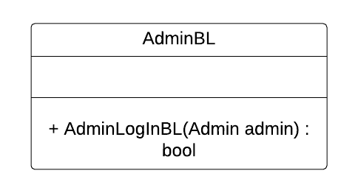
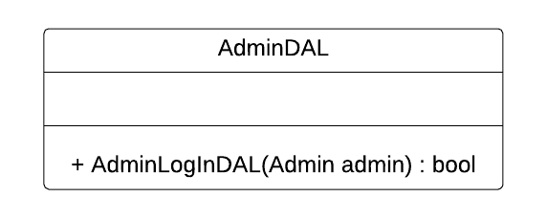
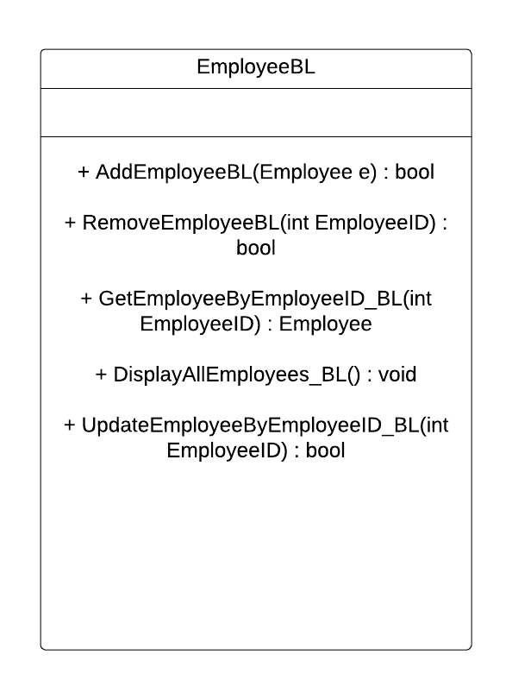
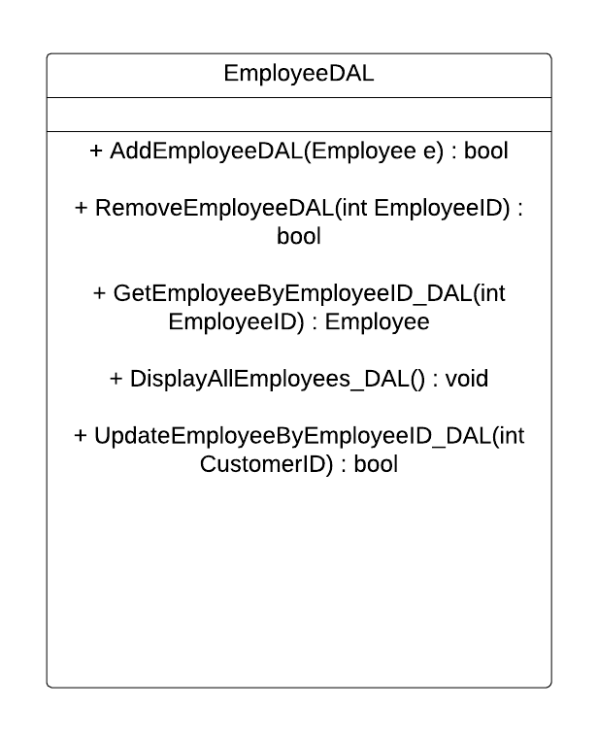
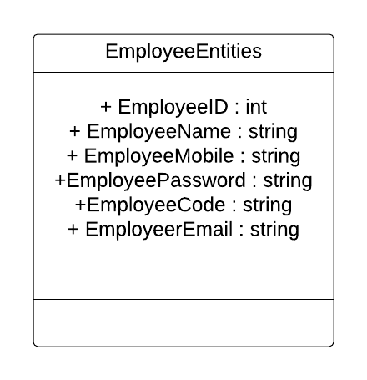
CLASS DIAGRAM OF ADMIN AND EMPLOYEE

Slide 7
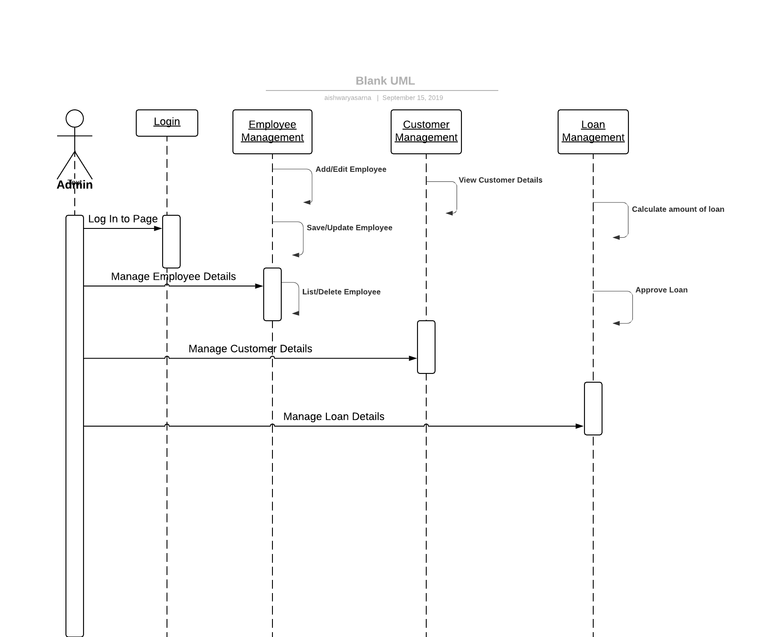
SEQUENCE DIAGRAM OF ADMIN

Slide 8
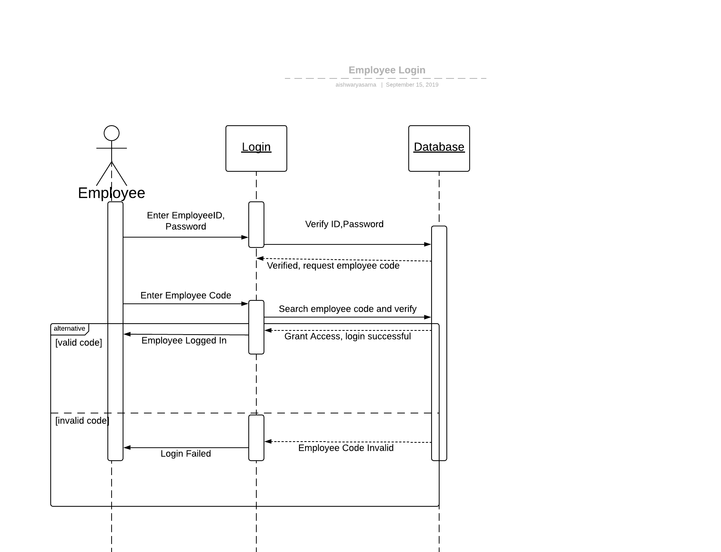
SEQUENCE DIAGRAM OF EMPLOYEE

Slide 9
THANK YOU

